Slide 1
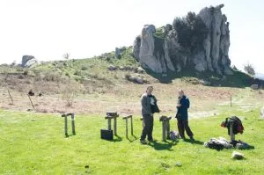
The Lab
To deal with the complex borrowing methods from arts and sciences, hacking through hard line concepts by playing together.
Open for all kind of people - can be set up anywhere
Space for experiment together

Slide 2
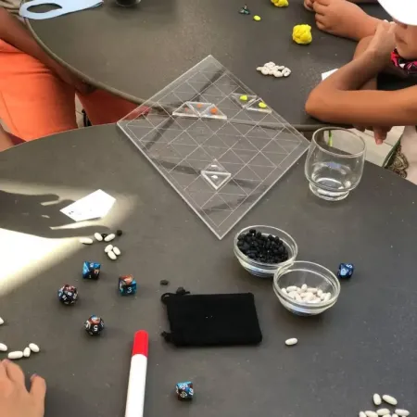
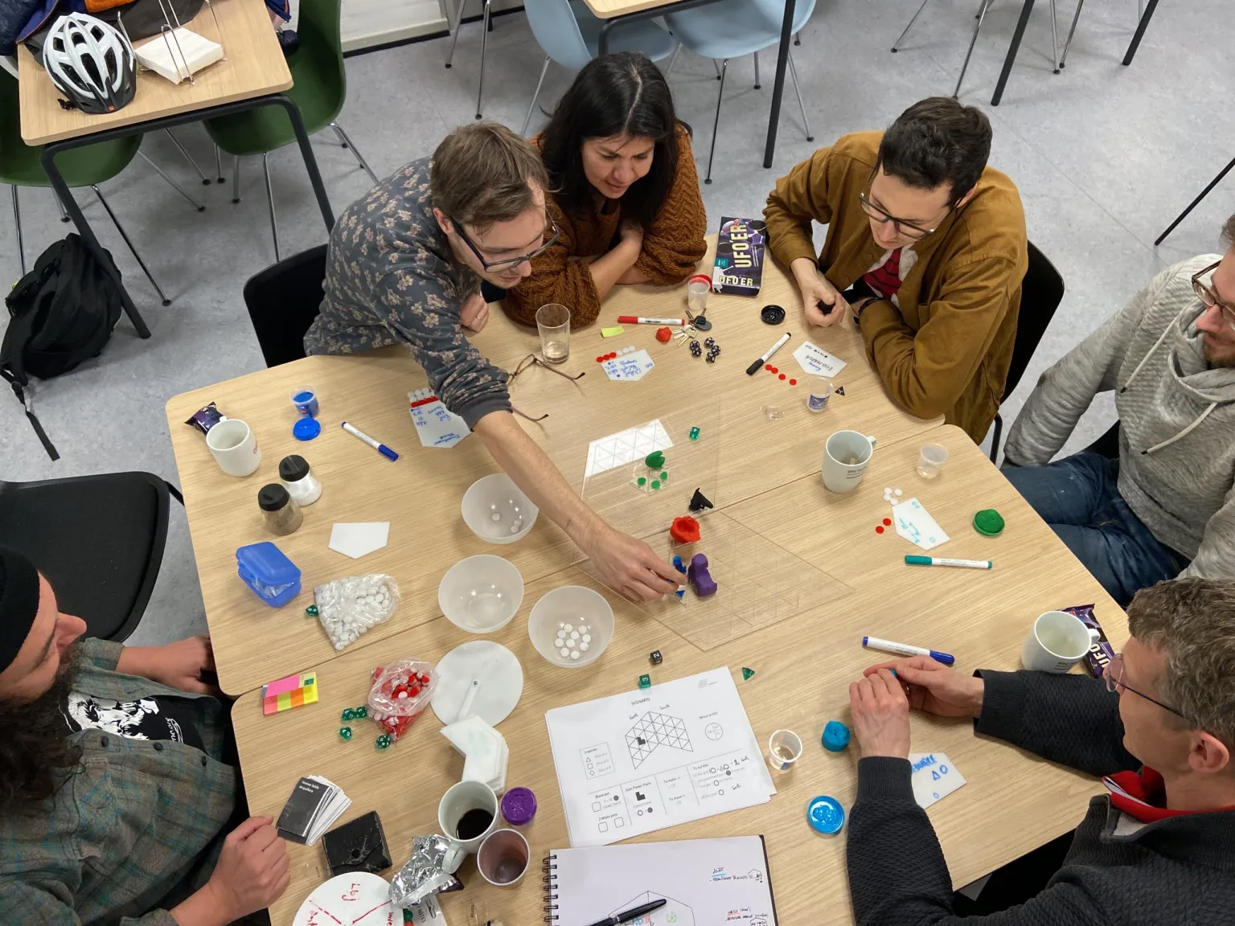
serious games :P
From hybrid games to simulation of real flows: engaging people to design their way through complex thoughts

Slide 3
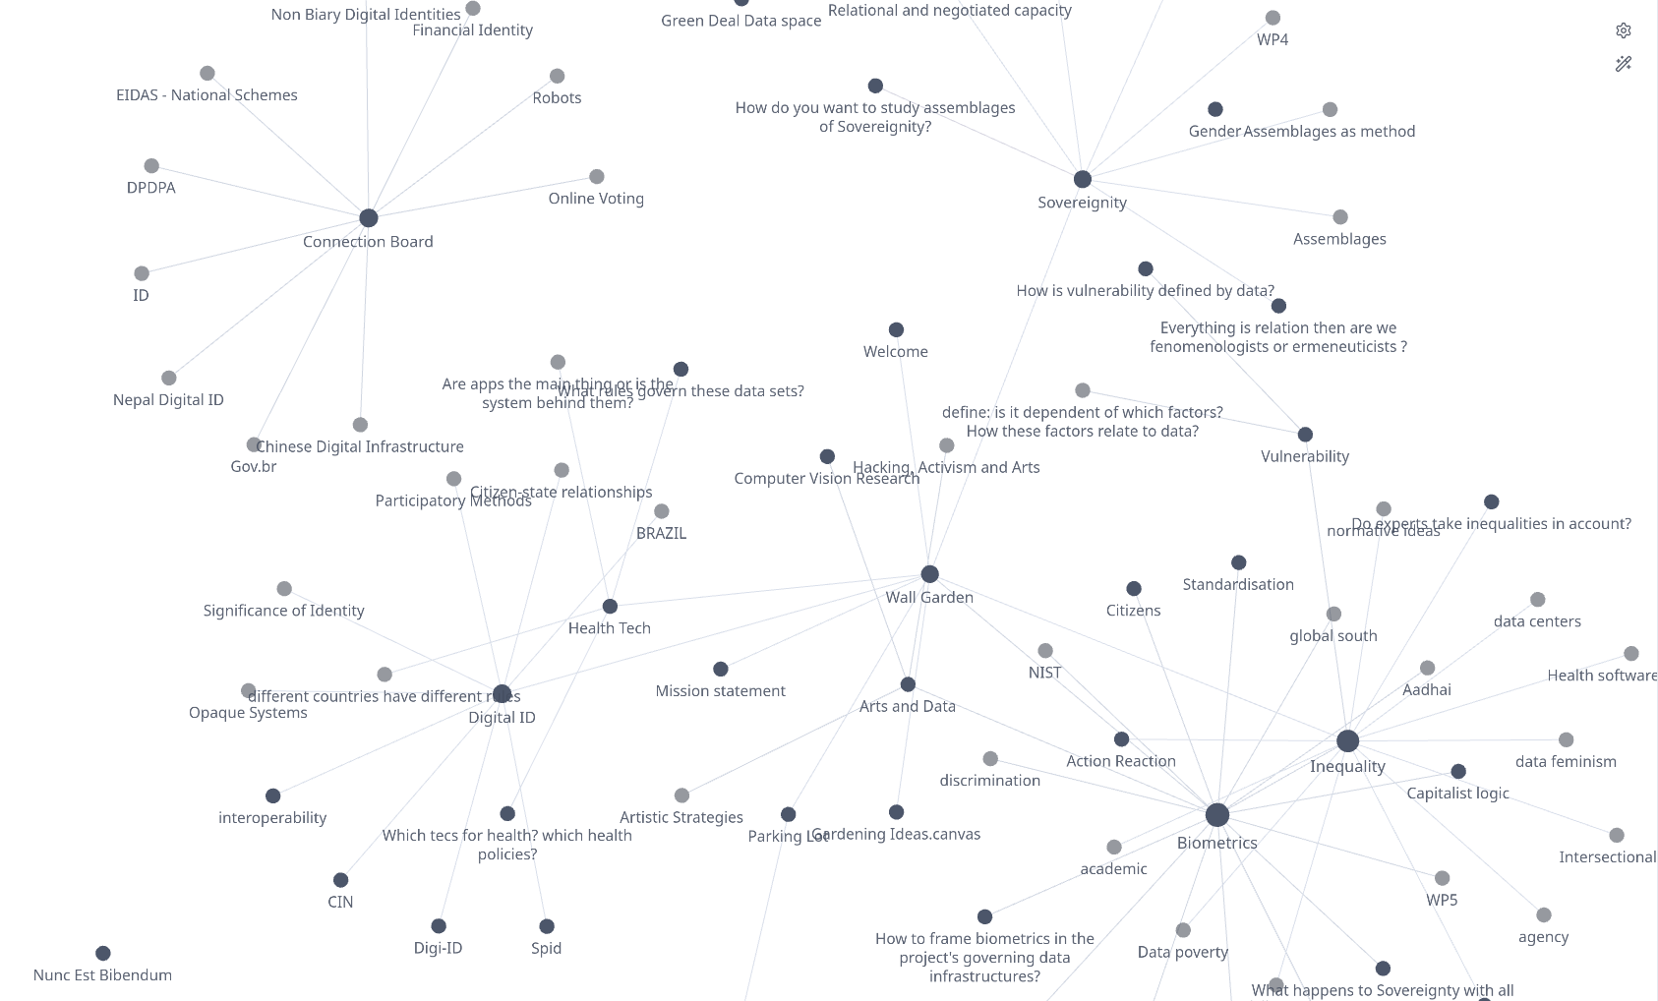
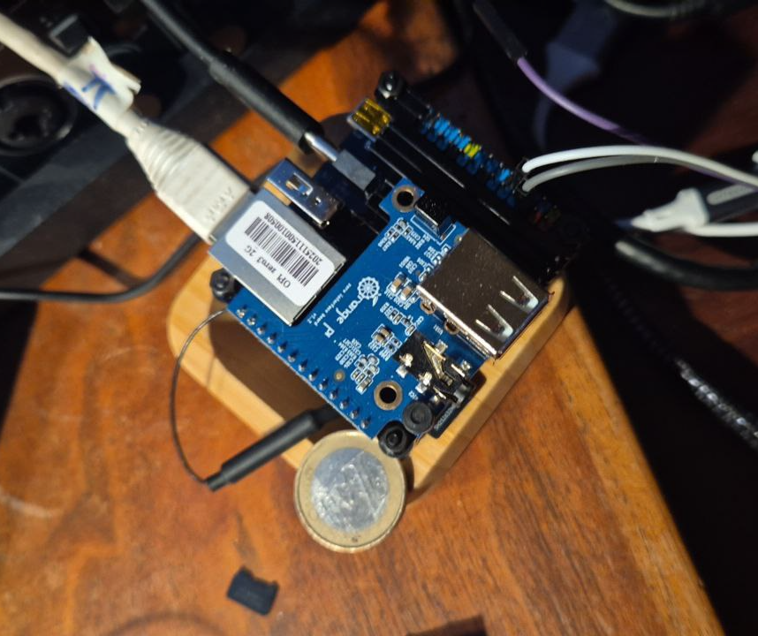
inter-personal infrastructures
How can we be more than one?

Slide 4
