Slide 1
DATAGOV
Kick-Off
27.03.2026 @Framer Framed

Slide 2
Today’s Agenda
10:00 – 10:45 | Welcome & Introduction
10:45 – 12:15 | Panel 1
Governing by data infrastructure: tensions and fault lines
12:15 – 13:15 | Lunch
13:15 – 14:45 | Panel 2
Global perspectives on governance by data infrastructure
14:45 – 15:15 | Closing Reflections
15:15 – 16:00 | Drinks

Slide 3
Welcome &
Introduction

Slide 4
DATAGOV Team
CARINA R. NASSER (they/them)
MATTÉO BARD (he/him)
SRUTHI VANGURI (she/her)
FEDERICO BONELLI
PhD Candidate
PhD Candidate
PhD Candidate
Artist in Residence
MEG KITAMURA (she/her)
GIULIA CAMPAIOLI (she/her)
JONAS BREUER (he/him)
STEFANIA MILAN (she/her)
Research Assistant
Postdoctoral Researcher
Postdoctoral Researcher
Principal Investigator

Slide 5
The Project

Slide 6







The Objective
Citizenship
Sovereignty
Inequality
Biometrics
E-Edu
E-Health
Digital IDs

Slide 7
The Methods

Slide 8
Panel 1
Governing by Data Infrastructure: Tensions and Fault Lines

Slide 9
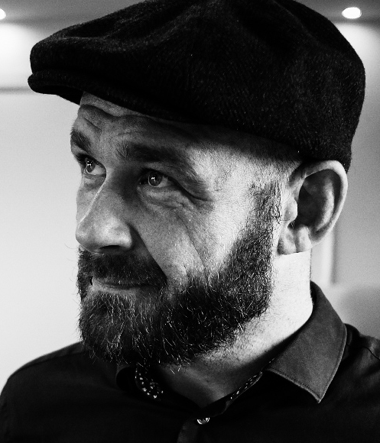
Panel 1
Governing by Data Infrastructure
LOUISE AMOORE
MIRCA MADIANOU
ROCCO BELLANOVA
NIELS TEN OEVER
Durham University
Goldsmiths, University of London
Vrije Universiteit Brussel
University of Amsterdam

Slide 10
Panel 2
Global Perspectives on Governance by Data Infrastructure

Slide 11
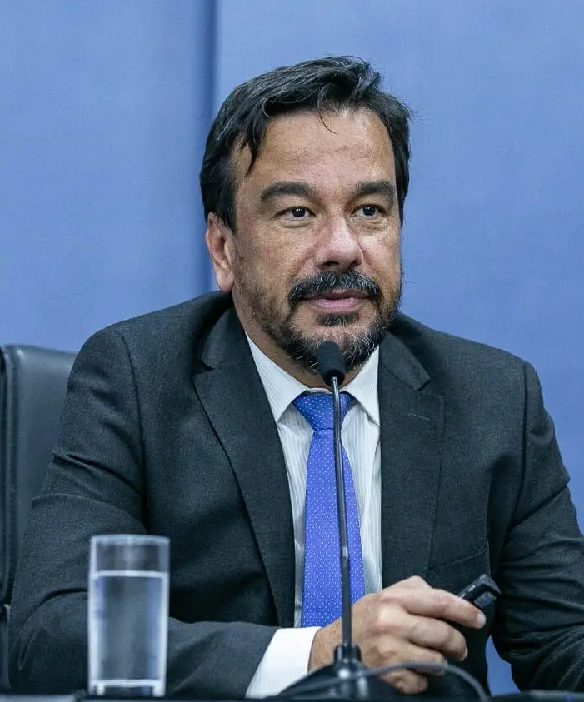
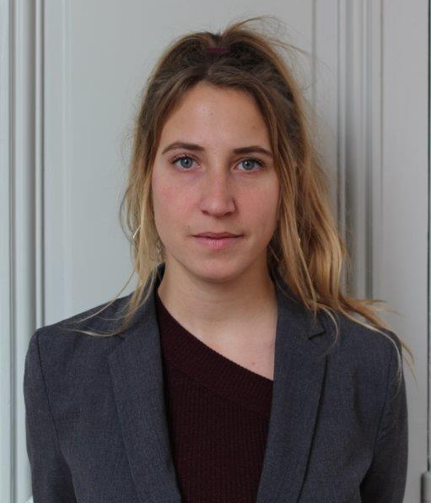
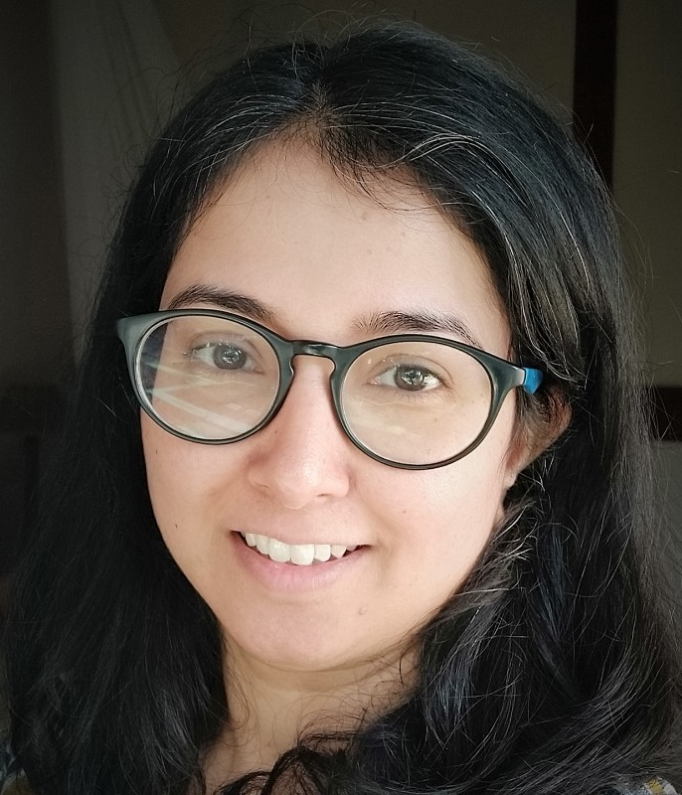
Panel 2
Global Perspectives on Governance by Data Infrastructure
FERNANDO FILGUEIRAS
CECILIA PASSANTI
BIDISHA CHAUDHURI
ROB VAN KRANENBURG
University of Goiás
Université Paris Cité
University of Amsterdam
IEEE Standards Association

Slide 12
Closing Remarks

