Slide 1

KICK-OFF
Governance by
Data Infrastructure
by
Framer Framed
27 – 03 - 2026

Slide 2
DAY 1
10:00–10:45 | | Welcome & introduction
10:45–12:15 | | Panel 1 Governing by data infrastructure: tensions and fault lines
12:15–13:15 | | Lunch
13:15–14:45 | | Panel 2 Global perspectives on governance by data infrastructure
14:45–15:15 | | Closing reflections
15:15 onwards | | Drinks

Slide 3
Welcome & Introduction
STEF
XXX

Slide 4

Panel 1- Governing by data infrastructure: tensions and fault lines
Moderated by Jonas Breuer (DATAGOV project)
Louise
Amoore
Durham University/ UK
Mirca
Madianou
Goldsmiths, University of London
Rocco
Bellanova
Vrije Universiteit Brussel
Niels
ten Oever
University of Amsterdam

Slide 5
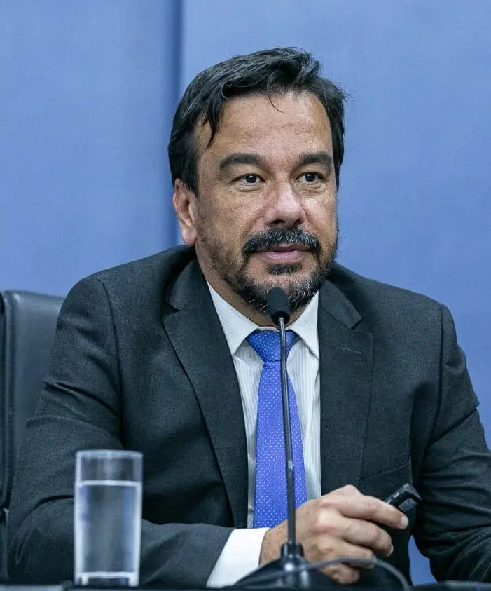
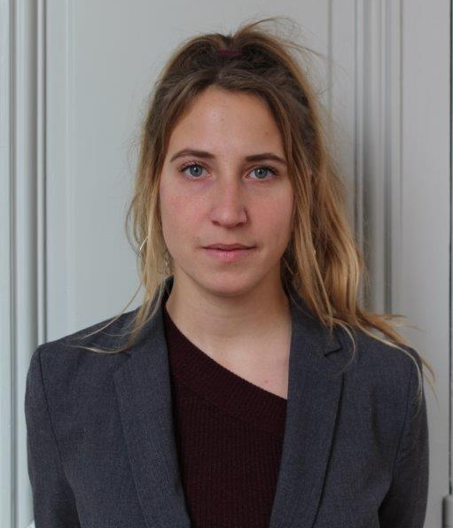
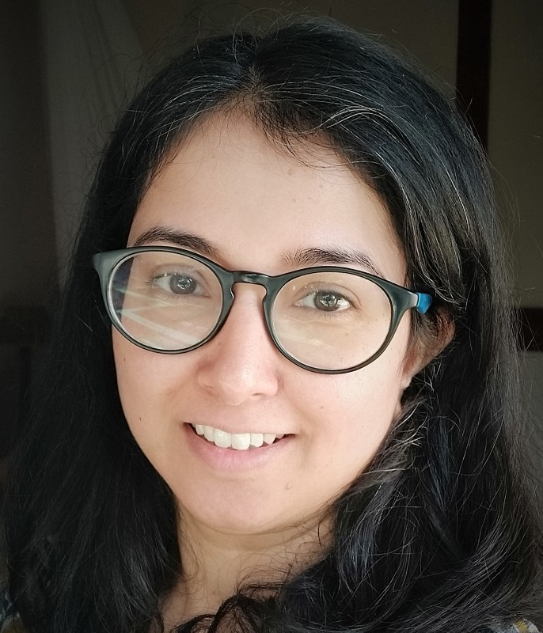
Panel 2 —Global perspectives on governance by data infrastructure
Moderated by Sruthi Vanguri (DATAGOV project)
Fernando Filgueiras
University of Goiás, Brazil
Cecilia
Passanti
Université Paris Cité, FR
Bidisha Chaudhuri
University of Amsterdam
Rob van Kranenburg
IEEE Standards Association

Slide 6
Closing Remarks

